Slide 1
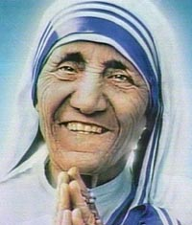
Mother Teresa Defies Gravity
By Quang Huynh
Anjeze Gonxhe Bojaxhiu
1910-1997

Slide 2
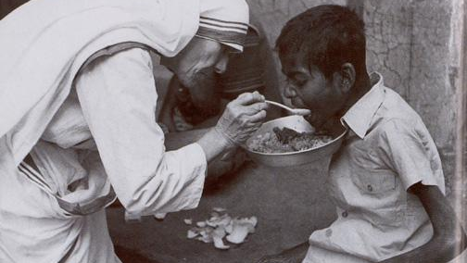
Lessons That We Can Learn From Mother Teresa
First of all, let’s see what Mother Teresa had learned from other people. So, some big life lessons that Mother Teresa learned is that, “Make other people happy.” because Mother Teresa gave to the poor, which made people look up to her and had made the poor of India very happy and glad that Mother Teresa gave “gifts” to them. Also, some themes in the book are kindness and how giving is caring. Some examples are “Caring for the sick and poor.” and “sharing it with others.” So, basically, those were lessons that we can learn form Mother Teresa. Be caring and generous.

Slide 3

Obstacles
Some obstacles and problems that Mother Teresa overcome is that, she was very poor. But then, she got a job, and had some revenue to pay her bills, and taxes. Another struggle that Mother Teresa had faced was that, her father died when she was only 8 years old. It was very hard for her. So, she had to live with her mother. Agnes was also very sick when she was little, so she read books and studied while she was in her bed. This is how she gained her knowledge while she couldn’t go to school. So, those were obstacles that Mother Teresa had faced and how she had handled those problems

Slide 4
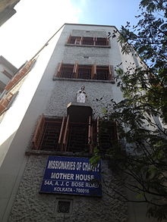
How Mother Teresa found Success
An accomplishment that Mother Teresa did was that, she had been considered as a living saint. She had gotten this amazing role by the following: Being nice, kind, and generous. Also, she had founded and created the Order of the Missionaries of Charity. This find had helped many people. The result of this? She was recognized and rewarded.

Slide 5
10 Fun Facts about Mother Teresa
Mother Teresa has won a Nobel Peace Prize.
Mother Teresa is the founder of the Order of Missionaries of Charity.
She was a teacher and taught in India for 17 years.
Pope Paul IV presented the Decree of Praise for the Order of Missionaries of Charity.
Mother Teresa was considered as a Saint.
She had experienced a “Call Within A Call” to devote herself for helping the poor.
Mother Teresa went to the Institute of Blessed Virgin Mary for school.
For College, Mother Teresa had went to Loreto Abbey, in Rathfarnham.
Her full name was Blessed Mother Teresa of Calcutta.
Her occupation, or job, was Nun, Saint.

Slide 6
Works Cited
Johnson, Emma. Mother Teresa. Austin, TX, Raintree, 2017. Print
“Mother Teresa” Biography.com. A&E Networks Television, 06, Sept 2016
Web. 23 Mar, 2017.

